Slide 1
Lecture 3 Binary Search
Abrar Hasan
Lecturer
Dept. of Software Engineering
Daffodil International University

Slide 2
Binary Search
<
T
3
>
Perquisite of Binary Search:
The array must be sorted

Slide 3
Binary Search
<
T
3
>
Steps:
1. Lets assume the array is sorted in ascending order.
2. At first we take two indexes,
left index is the first of the array
right index is the final of the array.
3. Then we find the middle index of the array
4. If the middle index and the diseased value is equal, the index is returned.
5. If Middle value is less than key value, left index = middle+1 index
6. If Middle value is greater than key value, right index = middle-1 index

Slide 4
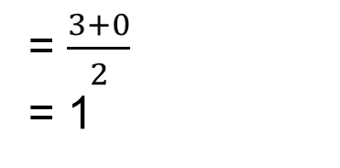
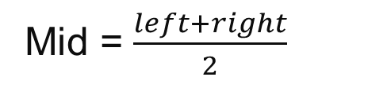
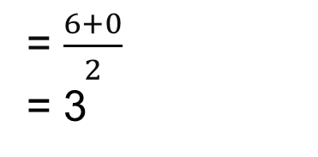

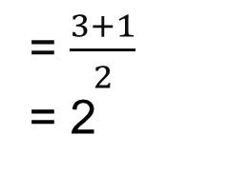
Binary Search
<
T
3
>
Target Number = 3
Mid = $\frac{left+right}{2}$
Mid = $\frac{left+right}{2}$
1
1
2
3
4
5
6
0
3
4
5
6
0
= $\frac{6+0}{2}$
= 3
= $\frac{3+0}{2}$
= 1
= $\frac{3+1}{2}$
= 2
1
2
5
6
7
1
2
3
4
5
6
7
4
4 == 3 ?
4 < 3 ?
2 == 3 ?
2 < 3 ?
4 > 3 ?
3 == 3 ?
2 > 3 ?

Slide 5
Binary Search
<
T
3
>
first = 0;
last = n - 1; //n=total length
middle = (first+last)/2;
while (first <= last) {
if (array[middle] < search)
first = middle + 1;
else if (array[middle] == search)
{
printf("%d found at location %d.\n", search, middle+1);
break;
}
else
last = middle - 1;
middle = (first + last)/2;
}
if (first > last)
printf("Not found! %d is not present in the list.\n", search);
1
2
3
4
5
6
7
8

Slide 6
Binary Search Time Complexity
<
T
3
>
0
1
2
3
4
5
6
7
O(log(n))

Slide 7
Thank You

